Slide 1
REVISION

Slide 2
File system vs DBMS
advantages/ disadvantages of file system. Limit?
DBMS components (hardware, software, people, procedure, data)
DBMS functions? (slide week 2)
Entity Relationship Model (ERM)
Chen notation/ Crow foot notation
Notes:
DBMS functions
- data dictionary/ data storage management
- security management/ multiuser access cobtrol
- backup & recovery
- data transformation & presentation
- database communication/ application programming interface
-

Slide 5
RDBMS
Primary Key (PK), Foreign Key (FK), Secondary Key, Candidate Key
Referential Integrity, Entity Integrity (slide week 4)
Entity Relationship Model (ERM)
1:M, 1:1, M:N
Notes:
Referential integrity: An FK may have either null entry or entry that match PK in original tbl. Eg: A customer may be assigned to a salesman Id, but impossible to have invalid salesman Id.
Entity integrity: PK entries are unique. Entry cannot null value. Eg: Invoice cannot hv duplicate invoice number.

Slide 6
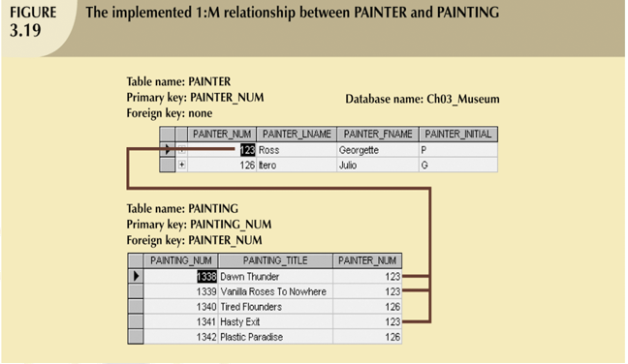

Slide 7
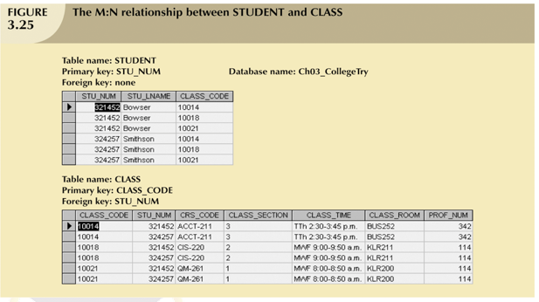

Slide 8
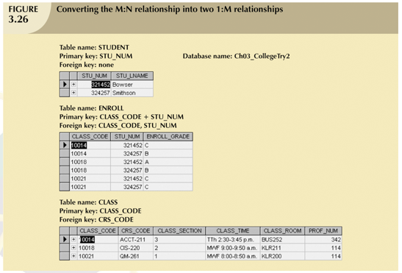

Slide 9
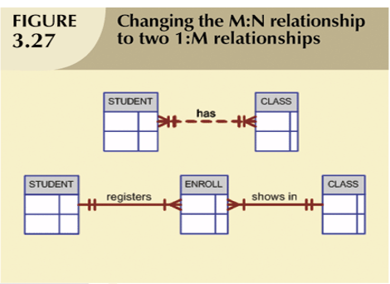

Slide 10
ERM
Entity, attribute, connectivity, cardinality (how to draw?)
Single-valued/multi-valued attributes (slide week 6)
Weak entity (characteristic? How to draw?)
Relationship degree (unary, binary, ternary…)
Composite entities

Slide 11
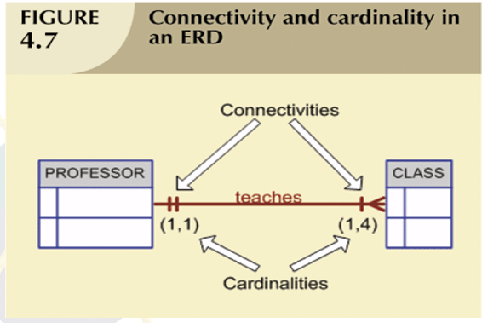

Slide 12
Normalization
UNF, 1NF, 2NF, 3NF
SQL
What is DDL, DML
Dependency (partial, transitive, full)
Common query –
SELECT, INSERT, UPDATE, DELETE,
CREATE TABLE, DROP TABLE,
JOIN, GROUP BY, HAVING, WHERE, ORDER BY
USING OPERATORS SUCH AS =, >=, AND, OR, BETWEEN, LIKE, DISTINCT, IN

Slide 14
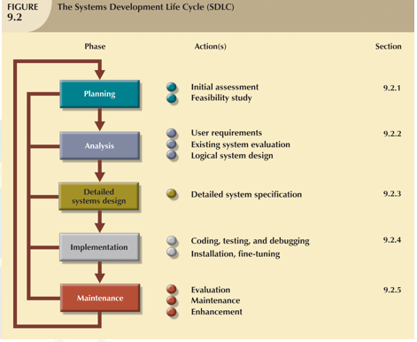

Slide 15
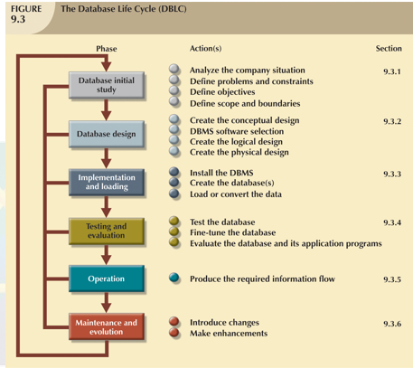

Slide 16
Final exam
Consists of 2 part
Part A: MCQ – 20 questions.
Part B: long answer – 3-4 questions with sub questions.
Physical Online Exam.

Slide 17
Referring to above table, write a query to display the name, including first_name and last_name and salary for all employees whose salary is out of the range between $10,000 and $15,000

Slide 18
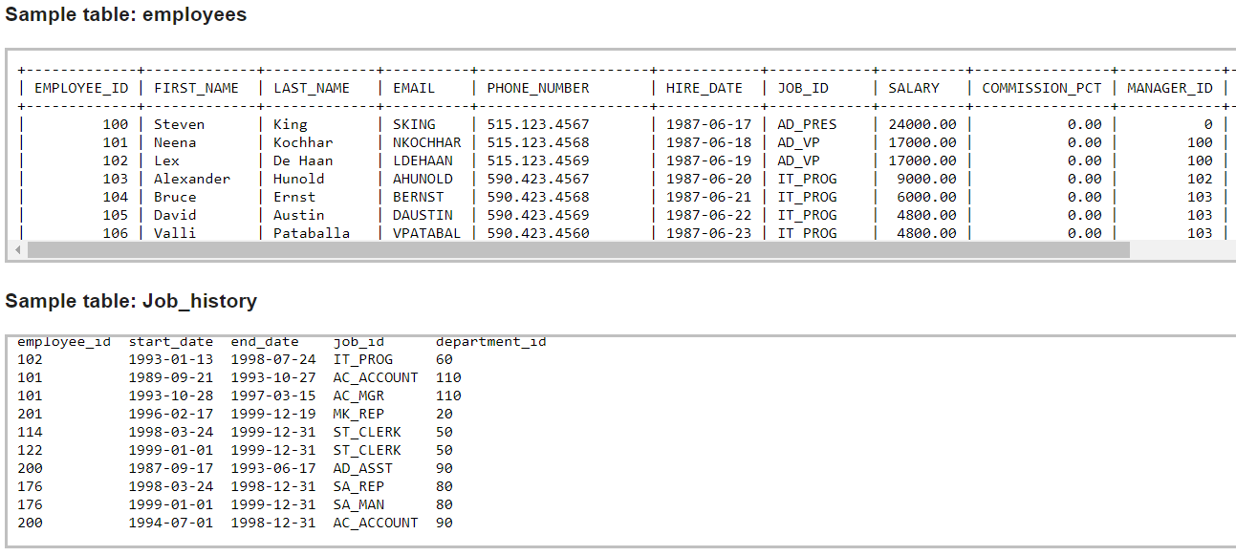
Write a query to make a join with two tables job_history and employees to display the status of employees who is currently drawing the salary above 10000.

Slide 19
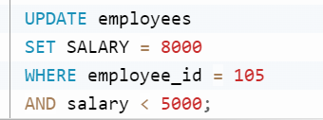
Write a SQL statement to change the salary of an employee to 8000 whose ID is 105, if the existing salary is less than 5000.

